Slide 1
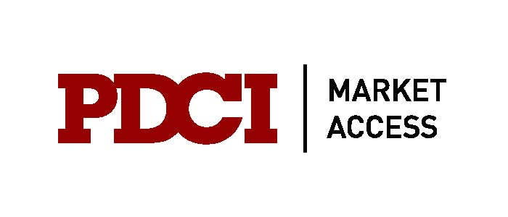
Anticipating and Adapting to Global Trends in Pharmaceutical Pricing and Reimbursement in Canada
W. Neil Palmer
President & Principal Consultant
Neil.Palmer@pdci.ca
The Canadian Institute
Drug Pricing & Reimbursement in Canada
Toronto – June 4 & 5, 2013
Notes:
1

Slide 2
Outline
Canada in a global P&R context
Value Based Pricing (UK) and AMNOG reforms (Germany)
Repercussions of international price referencing
HTA collaboration: Harmonization or collusion?
Implications of the Canada – EU Trade Agreement (CETA)
USA: Implementation of the Affordable Care Act

Slide 3
Canada in a Global Context

Slide 4
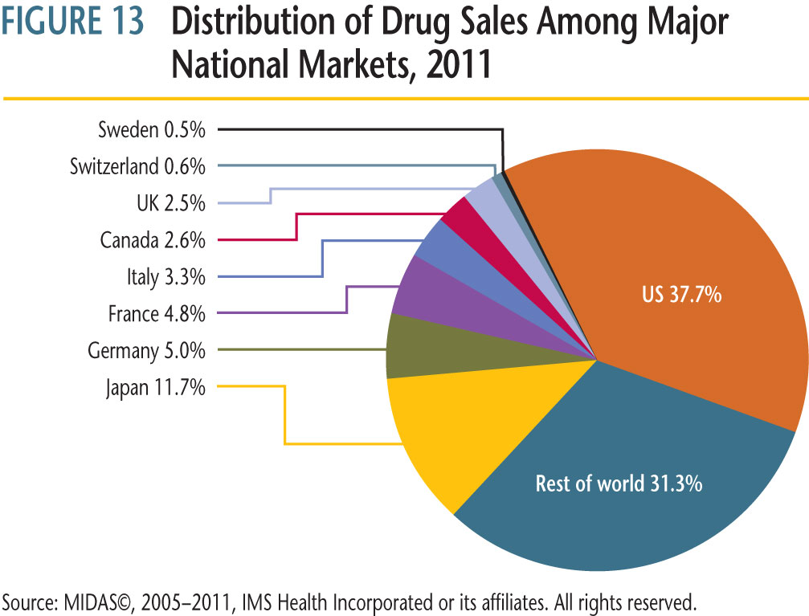
Canada as percentage of Global Market
In 2011, Canadian drug sales accounted for 2.6% of the global market

Slide 5
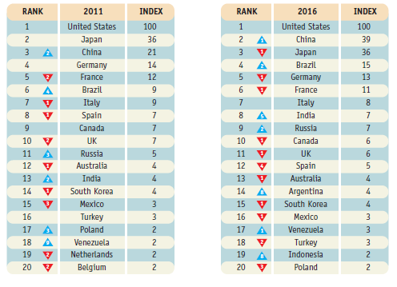
Canadian Pharma market larger than UK, Spain
Source: IMS Market Prognosis, May 2012

Slide 6
Who pays for prescription drugs in Canada?
Public (government funded) schemes
  Federal / Provincial Drug Plans
    Over 65 years of age, Social assistance, (welfare), High drug costs to Income
  Hospital in-patients (covered by hospital “global” budget)
  Cancer products – separate cancer agencies in Ontario and western provinces
  Vaccines: public health programs
  Blood products: blood agencies
  Workers Compensation
Private insurers
  Employer sponsored drug coverage for employees and their families
Consumers / Out of Pocket
  No coverage / uninsured / underinsured
    Unemployed, self-employed, small employers
  Non-reimbursed drugs (e.g., lifestyle drugs)
  Deductibles / co-payments
% Distribution of Rx Drug Expenditures
Canada 2011
$27.2 Billion
Source: Canadian Institute for Health Information (CIHI) , Drug Expenditure in Canada, 1985 – 2011 (Published 2012)

Slide 7
Pricing & Reimbursement in Canada
Pricing
(Patented Drugs)
Public Reimbursement / Funding
Private Reimbursement
Canada (except Quebec)
Canada
Non Cancer
Cancer
Quebec
Canada
Agency
PMPRB
CADTH/CDR
pCODR
INESSS
Private Insurers
Advice / Guidance
HDAP
CDEC
pERC
INESSS
Formulary Cmte / Plan Design
Decision Maker
PMPRB
Provincial Drug Plans, NIHB
Prov. Plans, Cancer Agencies
Minister of Health
Private Drug Plan Sponsor
Decision
Maximum Allowable Price
Formulary Listing Decision
Listing, Funding Decision
Formulary Listing Decision
Benefit Decision
Prim. Target Population
All
Over 65, Poor, Cost to Income
Cancer Patients
Over 65, Uninsured
Working Population

Slide 8
CADTH and Common Drug Review (CDR)
The CDR reviews new drugs and provides formulary listing recommendations to all publicly-funded drug benefit plans in Canada except Quebec
The CDR Directorate oversees clinical and P/E reviews but not budget impact (each drug plan reviews BI)
Each plan independently advises manufacturer of its listing decision and coverage status of the drug.
  Affordability / budget impact are the key factors for the drug plans
The pan-Canadian Oncology Drug Review (pCODR) reviews and provides recommendations for cancer drugs

Slide 9
Comparison of CDR and SMC Final Recommendations
(110 drugs reviewed by both CDR and SMC as of March 2013)
Scottish Medicine Consortium (SMC) is far more likely than the Canadian CDR to recommend new drugs be publicly funded.
Analysis suggests that CDR is unconvinced that new products offer incremental value when older, less expensive alternatives are available.
These results are consistent with other studies that concluded that CDR is more restrictive than decisions made by other HTA agencies.
Source: Canadian Agency for Drugs and Technology in Health (CADTH), Scottish Medicines Consortium (SMC)

Slide 10
International Changes that could impact Canadian Pricing
Germany
  AMNOG (Arzneimittelmarktneuordnungsgesetz) (2011-12)
United Kingdom
  Value based pricing (2014)
Other markets
  Mandatory price cuts
  Comparative effectiveness
Greater transparency by HTA agencies
  Greater emphasis on assessing therapeutic improvement
United States
  Affordable Care Act (Obamacare)
Canada – EU Free trade agreement
  PTR, DP to extend the jurisdiction of PMPRB ?

Slide 11
AMNOG (Germany)

Slide 12
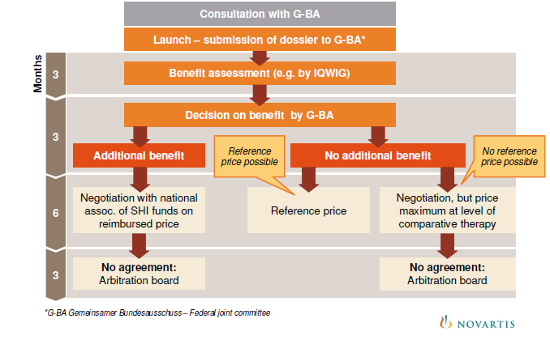
AMNOG Process – New Medicines
Source: Markus Jahn, Novartis Pharma GmbH, Pharma Pricing & Market Access Outlook, March 2012
Multi-stage , multi-agency process that can take up to 15 months

Slide 13
AMNOG: Price Implications of “Additional Benefit”
Additional Benefit | Price Discount Negotiation | Implications for Pricing | European Prices Considered
Major | Yes | Adjusted premium vs. the appropriate therapy in pricing negotiation | Yes
Important
Slight
Not Quantifiable | Yes | Similar to above | Yes
None | No (negotiation only if there is no reference group or comparator) | Reference price or at max. the price of the appropriate comparative therapy | No
Less Benefit | Yes | Discount vs. the appropriate comparative therapy | No
Adapted from: : Markus Jahn, Novartis Pharma GmbH, Pharma Pricing & Market Access Outlook, March 2012
Germany the latest country to adopt a formal mechanism to assess innovation (additional benefit, level of improvement)

Slide 14
“Additional Benefit”: GBA vs IQWiG
Source , IMS

Slide 15
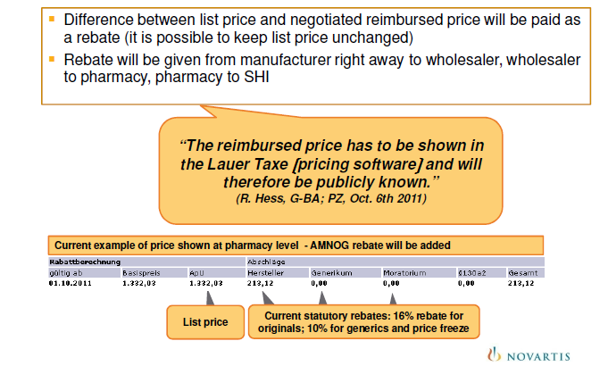
AMNOG – Rebates are public
Source: Markus Jahn, Novartis Pharma GmbH, Pharma Pricing & Market Access Outlook, March 2012
If German rebates remain public, prices throughout Europe and beyond (Canada!) will fall…

Slide 16
Lessons from Benefit Assessments in Germany
Selection of clinical comparators
  Head to head trials important
  No off-label comparators
Hard endpoints
  Mortality, morbidity, side effects considered to the exclusion of other evidence
  Surrogate markers the exception (e.g., SRV in hep-C)
Patient / sub-population segmentation
Quality- of-life outcomes ignored (no process defined as of yet)
No consideration of outside HTA analysis/recommendations
Lack of clarity in defining “additional benefit”
  How do trial outcomes translate into “additional beneifts”?
G-BA can and will overrule IQWiG
  Hearings before the G-BA an opportunity to provide additional information and to bring the patient/provider/payer perspectives into the process
Early engagement essential
Adapted from: AMNOG Seven Key Lessons for Strategic Market Decisions in Germany, IMS Pharma P&R, October 2012

Slide 17
Retrospective AMNOG reviews (and price cuts)
Source: Scrip
Several products launched pre-AMNOG are facing retrospective assessments and potential price cuts
  Possibility of retrospective reviews enshrined in AMNOG law
Criteria for selection:
  Cost (budget impact) to the sickness funds
  Therapeutic relevance
  Product life cycle: priority given to patented medicines 2-4 years post launch
  Must have one indication in common with a product that has gone through the AMNOG process
Products identified for AMNOG retrospective review:
  Nucynta [pain]
  Prolia, Protelos [osteoporosis]
  Pradaxa, Xarelto [atrial fibrillation, DVT, stroke]
  Victoza, Byetta [diabetes]
  Valdoxan, Cymblata [depression]
  RoActemra, Simponi, Cimzia [rheumatoid arthritis]

Slide 18
Value Based Pricing (UK)

Slide 19
Pharmaceutical Price Regulation Scheme (PPRS)
The Pharmaceutical Price Regulation Scheme (PPRS)
  Voluntary agreement between UK Health Departments and the Association of the British Pharmaceutical Industry (ABPI)
PPRS objectives:
  Secure provision of safe, effective medicines for the NHS at reasonable prices;
  Promote a strong and profitable pharmaceutical industry
  Encourage the efficient and competitive development and supply of medicines to pharmaceutical markets in this and other countries.
Source: UK Dept of Health, PPRS

Slide 20
History of PPRS
1957 First PPRS agreement
  Renewed every ~5 years
2008 Office of Fair Trading (OFT) recommended several changes including value based pricing (VBP)
2009 PPRS renewed (after consultations) without VBP but several new initiatives
  NICE reviews should ensure price reflects value
  Flexible pricing
  Cancer Fund
  Patient access schemes (PAS)
2010 Conservative / Liberal Democrat coalition government elected – commitment to VBP
2010 – 2013 Consultations / negotiations on proposed VBP system
2014 Implementation of new VBP system

Slide 21
Value Based Pricing: Objectives
Improve outcomes for patients through better access to effective medicines;
Stimulate innovation and the development of high value treatments;
Improve assessment process for new medicines, ensuring transparent, predictable and timely decision-making;
Wide assessment, alongside clinical effectiveness, of the range of factors through which medicines deliver benefits for patients and society;
Ensure value for money and best use of NHS resources.
Source: UK Department of Health December 2010: A New value based approach to the pricing of branded medicines:
A consultation

Slide 22
Outline of the Proposed Value Based Pricing System
Key elements
  To ensure that NHS funds are used to gain the greatest value for patients
  Value to be expressed in the terms of “cost-effectiveness threshold”
    QALY is one option (but not the only option)
  There will be a range of thresholds based on weightings of benefits:
Price thresholds:
  Basic threshold: reflecting the benefits displaced elsewhere in the NHS when funds are allocated to new medicines;
  Burden of Illness thresholds: for medicines that tackle diseases where there is greater “burden of illness”: the more the medicine is focused on diseases with unmet need or which are particularly severe, the higher the threshold;
  Innovation thresholds: for medicines that can demonstrate greater therapeutic innovation and improvements compared with other products;
  Societal benefit thresholds: for medicines that can demonstrate wider societal benefits.

Slide 23
Value Based Pricing – Extensive Consultations
Consultations began December 2010
Industry Reaction I (2010/11)
  We welcome the Government's proposal to take a broader view of benefits provided by medicines to patients when determining value, to include the disease burden of the condition to be treated and the level of innovation delivered by the medicine
  (Association of the British Pharmaceutical Industry (ABPI))
Industry Reaction II (2012)
  We are not convinced that value-based pricing will encourage innovation or reward the most effective medicines. In fact we are concerned that VBP could in fact stifle innovation because it will struggle to accurately reflect the inherent gradual and incremental nature of innovation
  (Association of the British Pharmaceutical Industry (ABPI))

Slide 24
Value Based Pricing Outlook
Current PPRS expires end of 2013
VBP must be in place by January 1, 2014 (along with new PPRS)
NICE to have an expanded role
But as of June 2013…
Negotiations between ABPI (industry association) and UK department of Health are continuing (behind closed doors); progress unknown
Changes to PPRS and initial impact of VBP expected to be “modest”
Majority of drugs expected to be procured under a variant of the current PPRS (given only ~30 HTA / year by NICE)
NICE expected to consider broader context beyond the QALY (e.g., burden of illness, societal benefits, innovation)
Price “negotiations” between manufacturer and department of health if/when necessary (patient access schemes under a new name?)
PPRS 2014 may include modulated (5-10%) price cut for existing products despite already low UK prices relative to other markets

Slide 25
International Price Referencing

Slide 26
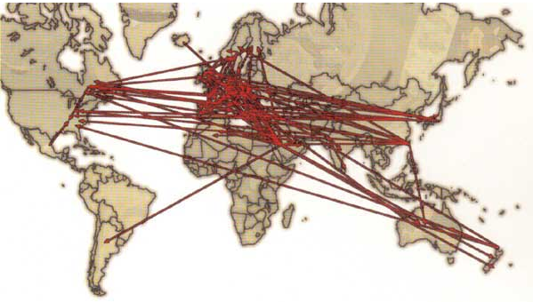
Impact of International Price Referencing (OECD)
International benchmarking (began in Canada in 1987)
Globalization, parallel and cross-border trade should lead to price convergence
Market harmonization and transparency in pricing prevent manufacturers from using price discrimination
Manufacturers use various strategies in order to maximize net revenues in the global market and counter spill-over effects of national policies
  Product launch strategies in a global market
  Pricing strategies in a global market
  Strategies to avert parallel or cross-border trade
  Non-transparent risk sharing
Overall the impact of international price referencing is lower prices globally
  Source: OECD Pharmaceutical Pricing Policies in a Global Market, 2008

Slide 27
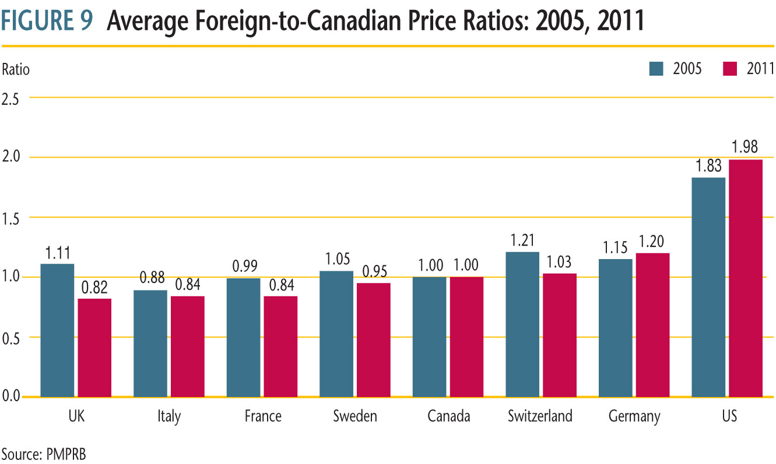
Foreign to Canadian Prices

Slide 28
Average Foreign to Canada Price Ratios, Patented Medicines
*US is WAC price only, 2011 is estimated

Slide 29
Impact of Exchange Rates

Slide 30
Price Changes in PMPRB reference countries

Slide 31
International HTA Collaboration

Slide 32
International HTA Collaboration
HTA Collaboration is extensive
  but generally limited to sharing information on methods, process and definitions for HTA
There is also collaboration with regulators (e.g., EMA) with respect to development of clinical evidence
To date, there is no collaboration on individual technology assessments or on pricing
  However there is considerable transparency with respect to HTA decisions and rationale
  Most HTA agencies publish their assessments and most make at least a summary available in English

Slide 33
HTA collaboration in Europe: EUnetHTA
EUnetHTA is network of government appointed organisations and relevant regional agencies, non-for-profit organisations that produce or contribute to HTA in Europe
EUnetHTA was established to create an effective and sustainable network for HTA across Europe
HTA agencies working together to help develop reliable, timely, transparent and transferable information to contribute to HTAs in European countries by:
  facilitating efficient use of resources available for HTA
  creating a sustainable system of HTA knowledge sharing
  promoting good practice in HTA methods and processes
HTA Core Model®
  methodological framework for shared production and sharing of HTA information.

Slide 34
INAHTA:
International Network of Agencies for Health Technology Assessment
Non-profit organization was established in 1993
Grown to 57 member agencies from 32 countries including North and Latin America, Europe, Africa, Asia, Australia, and New Zealand.
All members are non-profit making organizations producing HTA and are linked to regional or national government
INAHTA´s mission is to provide a forum for the identification and pursuit of interests common to HTA agencies. The network aims to:
  Accelerate exchange and collaboration among agencies
  Promote information sharing and comparison
  Prevent unnecessary duplication of activities

Slide 35
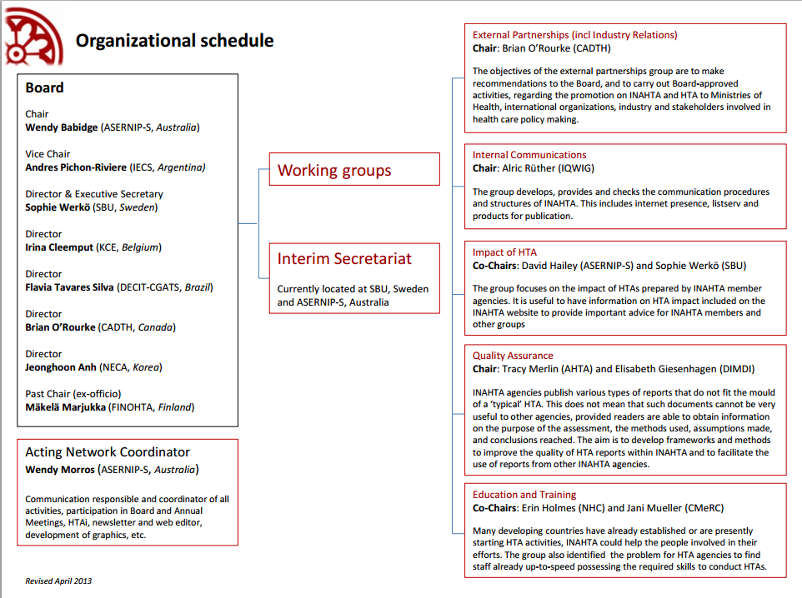
INAHTA
International Network of Agencies for Health Technology Assessment

Slide 36
Canada – EU Free Trade Agreement

Slide 37
Canada - EU Trade Agreement - CETA
EU and Canada in negotiations for Comprehensive Economic and Trade Agreement (CETA): Pharma IP Provisions:
Patent Term Restoration (PTR)
  To compensate for regulatory delays
  PTR would provide up to 5 additional years of patent protection for a product but would be limited to a maximum period of market exclusivity (say 15 years)
Extended Data Protection
  Current Canadian Data Protection is 8 years (plus six months for pediatric)
  Europe is 10 years (plus one year for new uses and six months for pediatric)
  US is 5 years plus 3 years for new uses and an additional six months for pediatric
    12 years data protection for biologics
  US & Europe have Orphan Drug legislation (not available in Canada) with 7 – 10 years of market exclusivity
Innovator Right of Appeal
  Currently only generics have effective right of appeal under PM(NOC) proceedings
  Once an NOC is issued to a generic Innovator`s only recourse is long and costly patent infringement proceedings
  An innovator right of appeal would provide a limited period for an innovator to appeal a PM(NOC) decision but would not affect the 24 month limit

Slide 38
US Affordable Care Act

Slide 39
Affordable Care Act Implications for drug pricing
Passed in 2010, Affordable Care Act (Obamacare) a major expansion and regulatory change in US healthcare coverage.
“Donut hole: Coverage gap between basic and catastrophic drug coverage
  ACA helps close the “donut hole” for Part D Medicare recipients (senior)
  Gradual discounts to patients falling in donut hole.
    In 2012, patients pay 50% for brand-name drugs and 86% for generics.
    By 2020, patients will pay 25% for brand-name and generic drugs.
ACA provides no mechanism for lowering US drug prices and precludes consideration of cost or cost effectiveness in listing decisions by medicare.
  US prices increased by ~10% in 2012
Increasing drug costs not regulated by legislation however:
  states and insurers moderate drug costs through tiered plans, low cost generics, tendering and rebates
Sources:
Healthcare.gov Donut Hole, Prescription Drug. http://www.healthcare.gov/glossary/d/donuthole.html
Healthcare.gov. Medicare Drug Discounts. http://www.healthcare.gov/law/features/65-older/drug-discounts/

Slide 40
Outlook

Slide 41
Outlook
Economic crisis resulting in cuts in health (and drug) budgets
The focus on “value” does not address affordability
International price referencing pushing prices down
“Therapeutic improvement” / “additional benefit” the basis for establishing prices and levels of reimbursement
Health economics is evolving into a mechanism for engineering prices
  (e.g., Value based pricing in the UK)
Risk sharing schemes a stop gap measure to address clinical uncertainty
Expectation that relevant clinical evidence will be available at launch
  Early engagement to assess evidence requirements essential
HTA agency collaboration to harmonize definitions but not decisions
Ethical, societal perspectives, patient involvement to expand

Slide 42
Thank you

Slide 43
Biography
W. Neil Palmer
President & Principal Consultant
PDCI Market Access Inc
Neil.Palmer@pdci.ca
www.pdci.ca
Neil Palmer is President and Principal Consultant of PDCI Market Access Inc (PDCI) a leading pricing and reimbursement consultancy founded as Palmer D’Angelo Consulting Inc (PDCI) in 1996. In addition to PDCI, Neil has worked with RTI Health Solutions, the Patented Medicine Prices Review Board (PMPRB), the Health Division of Statistics Canada and the research group of the Kellogg Centre for Advanced Studies in Primary Care in Montreal. He has more than 20 years of experience in pharmaceutical pricing and reimbursement and is a frequent speaker at pharmaceutical conferences in North America and Europe.
PDCI Market Access (PDCI) is a leading pharmaceutical pricing and reimbursement consultancy. Established in 1996, the firm features a senior team of market access professionals with extensive experience assisting clients navigate the complex pricing and market access challenges facing pharmaceutical manufacturers. PDCI helps pharmaceutical companies develop successful pricing and reimbursement strategies and prepare comprehensive submissions to public & private payers and price regulators. PDCI also maintains and extensive database of international pharmaceutical prices.

